Slide 1

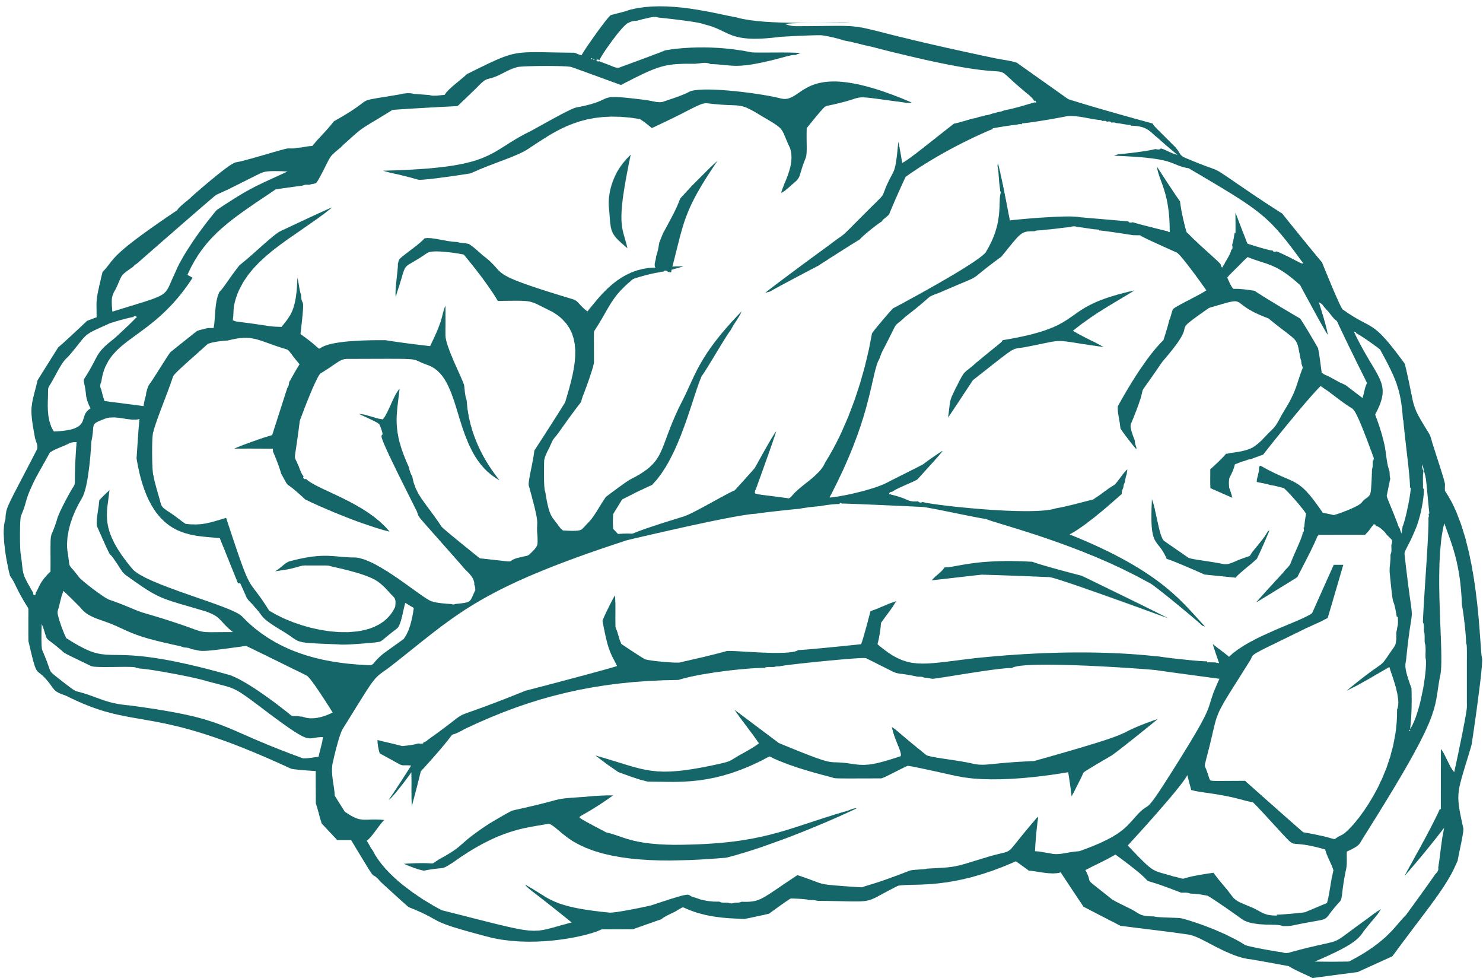
Predicting Dementia
Using Machine Learning Models
Vi Bui, Tasha Do, Harun Esse, Muzaffar Amin

Slide 2
01.
Project Overview and Research Questions
02.
Dataset Features
03.
Machine Learning Model: Deep Neural Network (initial and optimised)
Outline
04.
Machine Learning Model: Random Forest Model
05.
Feature Importances
06.
Model Applications
07.
Conclusion

Slide 3
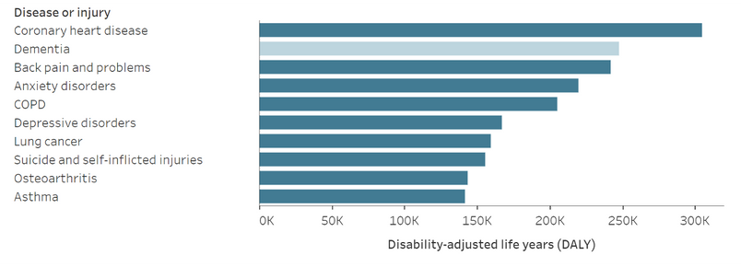


https://www.dementia.org.au/about-dementia/dementia-facts-and-figures
https://www.aihw.gov.au/reports/dementia/dementia-in-aus/contents/summary#Common
What is dementia?
Number of Australian’s with dementia is expected to increase by 50% by 2054
Dementia is the term used to describe the symptoms of a large group of illnesses which cause a progressive decline in a person’s functioning. It is a broad term used to describe a loss of memory, intellect, rationality, social skills and physical functioning.
Number of Australian’s with younger onset dementia is expected to increase by 33% by 2054
2nd leading cause of death for Australians

Slide 4




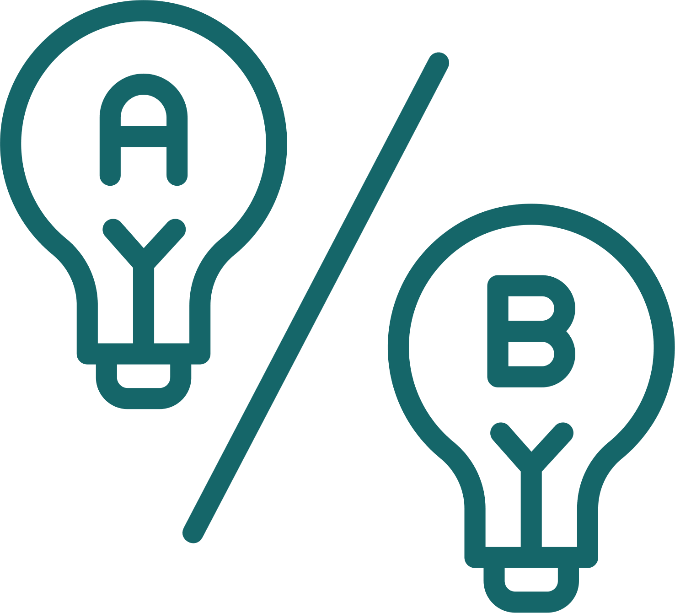

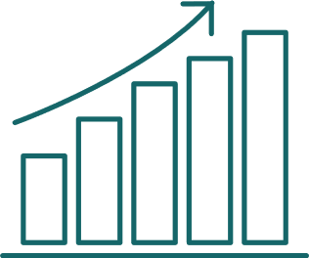

Research Questions
Disease-Specific
General
What factors are most strongly associated with the risk of developing dementia?
What role does genetic data play in enhancing the accuracy and personalisation of dementia predictions
How early can we predict the onset of dementia with reasonable accuracy?
Can prediction models help optimise
healthcare resource allocation for chronic disease management?
Prediction Accuracy: How accurately can we predict the onset of dementia using demographic, lifestyle, and medical data?
Model Performance: How do different machine learning models (Deep Neural Networks and Random Forest,) compare in terms of prediction accuracy and robustness?
Feature Importance: Which features (e.g., age, gender, lifestyle factors, medical history) are the most significant predictors for dementia?

Slide 5



Diabetic
Prescription
Dosage in mg
Depression Status
Medication History
Chronic Health Conditions
Medical
History
Dataset Features
Alcohol level
Education Level
Smoking Status
Physical Activity
Nutrition Diet
Sleep Quality
Target Label: Dementia
Data source: Kaggle.com
Lifestyle
Heart rate
BloodOxygenLevel
BodyTemperature
Weight
MRI Delay
Age
Dominant Hand
Gender
Cognitive Test Scores
General
Stats
Family History
APOE ε4
Genetics

Slide 6
Machine Learning Model
Deep Neural Networks - Initial
Input layer:
45 features
Hidden layer 1
5 neurons with ReLU
Hidden layer 2
2 neurons with ReLU
Output
1 neuron with Sigmoid
Optimizer: Adam
Loss function: binary_crossentropy
Evaluation metrics: accuracy
Epocs: 15
Layer (type) | Output Shape | Param #
dense (Dense) | (None, 5) | 230
dense_1 (Dense) | (None, 2) | 12
dense_2 (Dense) | (None, 1) | 3
Total params: 245 (980.00 B)
Trainable params: 245 (980.00 B)
Non-trainable params: 0 (0.00 B)

Slide 7
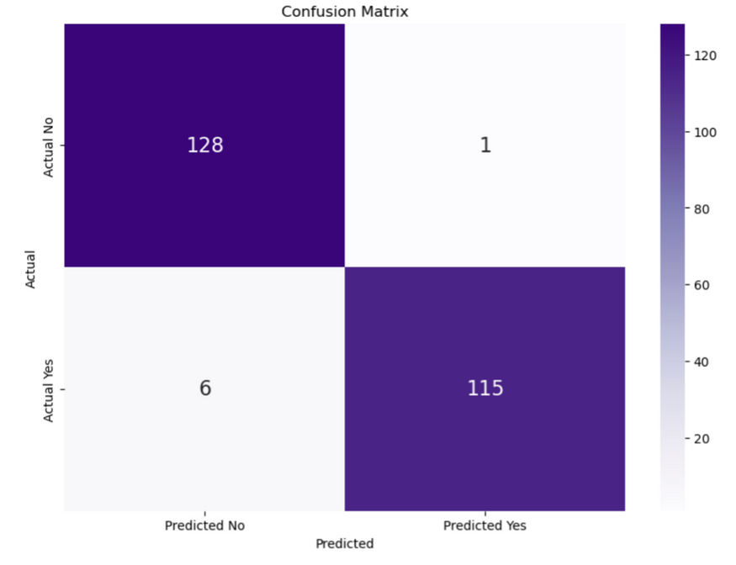
Machine Learning Model
Deep Neural Networks - Initial
 | Precision | Recall | f1-score | support
0 (No dementia) | 0.96 | 0.99 | 0.97 | 129
1 (Dementia) | 0.99 | 0.95 | 0.97 | 121
Accuracy |  |  | 0.97 | 250
Macro avg | 0.97 | 0.97 | 0.97 | 250
weighted avg | 0.97 | 0.97 | 0.97 | 250

Slide 8
Machine Learning Model
Deep Neural Networks - Optimised
Input layer:
45 features
Hidden layer 1
8 neurons
ReLU
Hidden layer 2
5 neurons
ReLU
Hidden layer 3
2 neurons
ReLU
Output
1 neuron
Sigmoid
Optimizer: Adam
Loss function: binary_crossentropy
Evaluation metrics: accuracy
Epocs: 25
Layer (type) | Output Shape | Param #
dense (Dense) | (None, 8) | 368
dense_1 (Dense) | (None, 5) | 45
dense_2 (Dense) | (None, 2) | 12
dense_3 (Dense) | (None, 1) | 3
Total params: 428 (1.67 KB)
Trainable params: 428 (1.67 KB)
Non-trainable params: 0 (0.00 B)

Slide 9
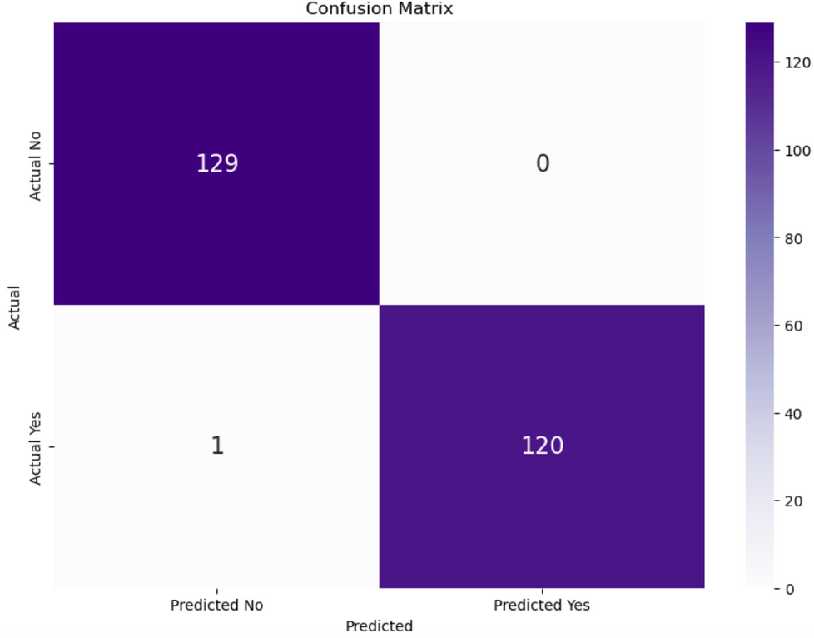
Machine Learning Model
Deep Neural Network - Optimised
 | Precision | Recall | f1-score | support
0 (No dementia) | 0.99 | 1.00 | 1.00 | 129
1 (Dementia) | 1.00 | 0.99 | 1.00 | 121
Accuracy |  |  | 1.00 | 250
Macro avg | 1.00 | 1.00 | 1.00 | 250
weighted avg | 1.00 | 1.00 | 1.00 | 250

Slide 10
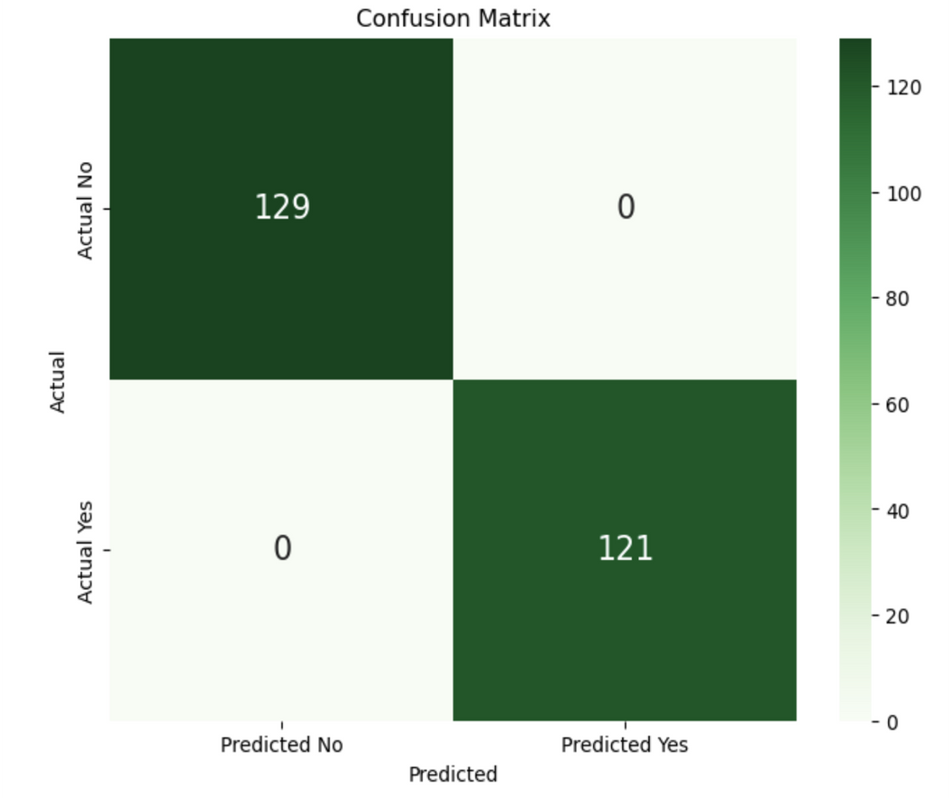
Machine Learning Model
Random Forest Model
 | Precision | Recall | f1-score | support
0 (No dementia) | 1.00 | 1.00 | 1.00
1 (Dementia) | 1.00 | 1.00 | 1.00 | 121
Accuracy |  |  | 1.00 | 250
Macro avg | 1.00 | 1.00 | 1.00 | 250
weighted avg | 1.00 | 1.00 | 1.00 | 250

Slide 11
Machine Learning Model
Model Performance
 | Precision | Recall
0 (No dementia) | 0.99 | 1.00
1 (Dementia) | 1.00 | 0.99
Accuracy |  |  | 1.00
 | Precision | Recall
0 (No dementia) | 1.00 | 1.00
1 (Dementia) | 1.00 | 1.00
Accuracy |  |  | 1.00
Deep Neural Network (Optimised)
Random Forest Model
How accurately can we predict the onset of dementia using demographic, lifestyle, and medical data?
With up to a 100 percent accuracy . Accuracy of the prediction depends on the quality and comprehensiveness of the data used by the machine learning model.
How do different machine learning models (Deep Neural Networks and Random Forest) compare in terms of prediction accuracy and robustness?
Both models are highly reliable, but the Random Forest model demonstrates a slightly superior capability in this case.

Slide 12
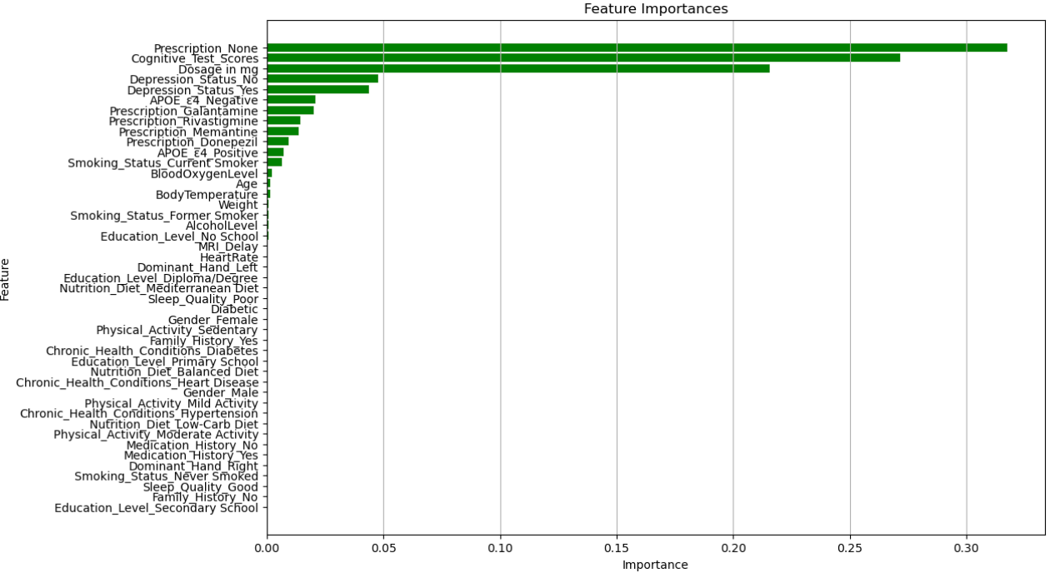
Feature Importances
Which features are the most significant predictors for dementia?
Prescriptions, cognitive test scores, and medication dosage
What lifestyle and genetic factors are most strongly associated with the risk of developing dementia?
Depression status and the APOE ε4 allele, both known to be associated with dementia, have moderate importance.
Other Health Metrics: Traditional health metrics like Alcohol Level, Blood Oxygen Level, and Age have relatively low importance in this model.
Lifestyle and Demographics: Physical activity, education level, and smoking status also show low importance, suggesting that the model relies more on direct indicators of cognitive health and treatment.

Slide 13
Model Applications
03.
Support the healthcare system in forecasting how to allocate resources (i.e. finance, research)
01.
Identify patients who are at high risk of developing dementia using a ML model
100%
The
accurate model can be used to identify at-risk patients and lead to earlier interventions.
The MLM can predict the growth and proportion of the Australian population to support the government allocate resources more effectively (i.e. planning healthcare services, support programs, infrastructure needs).
02.
Empower at-risk patients to undertake preventative measures by changing modifiable risk factors
A MLM can analyse large datasets from studies, research and other sources, that can generate new insights and potentially lead to the development of new treatments.
04.
Accelerate dementia research
MLM can identify modifiable risk factors (I.e. alcohol, smoking) that can be proactively changed by indivisuals to delay the onset of dementia.

Slide 14
Conclusion
Deep Neural Networks: Achieved high accuracy but required additional optimisation to reach an overall accuracy of 1.0.
Random Forest Model: Achieved perfect classification outcomes for both classes, with no false negatives or false positives, resulting in a perfect accuracy score of 1.0.
Model Reliability: Both models demonstrate exceptional reliability and effectiveness for practical applications in medical diagnostics and research.
Feature Importance Analysis: Highlighted prescriptions, cognitive test scores, and medication dosage as the top contributing factors in predicting dementia. The APOE ε4 gene variant showed only moderate importance for prediction.
Practical Applications: Both machine learning models provide opportunities for practical use, including:
Early Medical Diagnosis
Government Resource Allocation in Disease Management
Research in the Area
Empowering At-Risk Patients to undertake preventative measures by modifying risk factors such as smoking, alcohol intake, obesity, physical inactivity, and poor diet.

